Slide 1

Team5
Project 2
Pandemic
Propagation
Vaishall Pradeepkumar
Youssef Mroue
Eliana Suarez
Xiaodi Lin
02.27.2020

Slide 2
Background:
The coronavirus that originated in China has spread fear and anxiety around the world in every corner since New Year 2020. This deadly virus pandemic again was caused by humans who were irresponsible and went against natural law. The goal of this analysis is to raise public awareness and educate people who are interested in this topic.
Data:
Coronavirus: https://github.com/CSSEGISandData/COVID-19/
SARS: https://www.who.int/csr/sars/country/table/en/
H1N1: https://www.kaggle.com/de5d5fe61fcaa6ad7a66/pandemic-2009-h1n1-swine-flu-influenza-a-dataset
Geographic: https://cdn.jsdelivr.net/npm/world-atlas@2/countries-110m.json
Analysis:
For better showing the lessons we learned from our history, we added other respiratory viruses in our analysis. Our horizontal comparison analysis demonstrates a the spread pattern of those similar viruses over time.

Slide 3


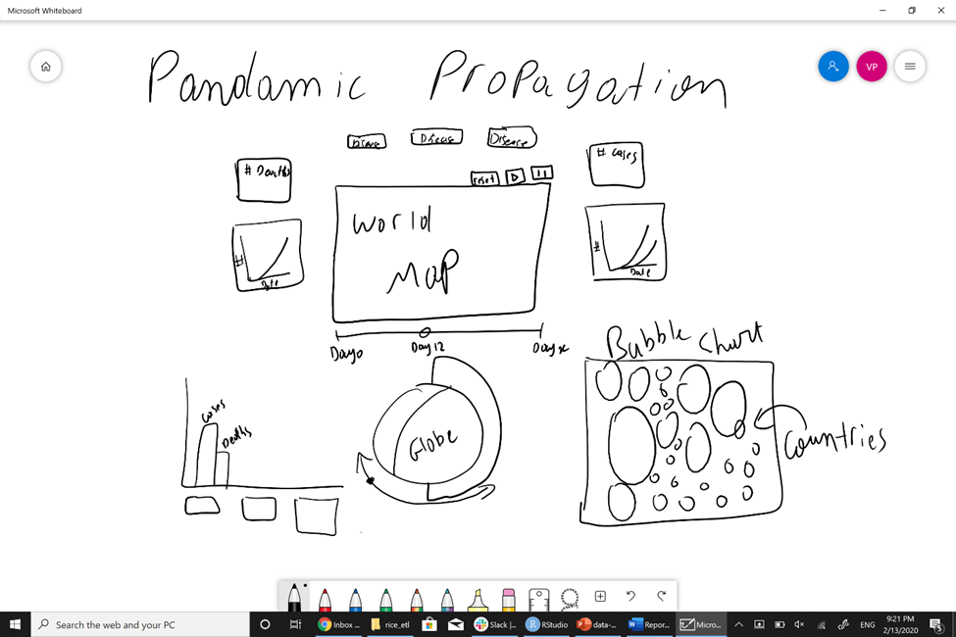
Project Design:

Slide 4

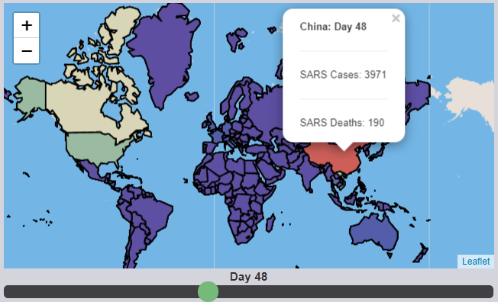
Close look of each part on the project
Map
Map is one of the best tool for visualizing the density of viruses spreading over the world with the color scale.

Slide 5
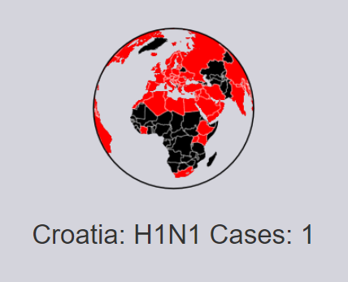
The dynamic globe demonstrates a model how viruses spread from one region to another violently and globally

Slide 6
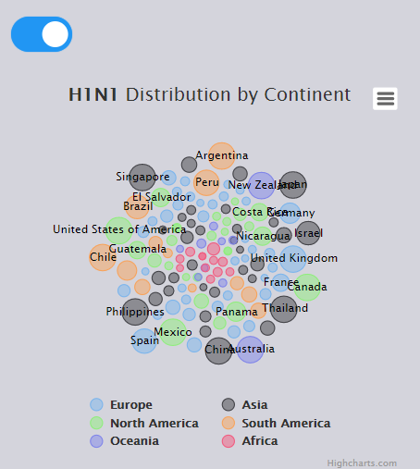
Bubble plot is another attractive way for demonstrating data.
The specialty in this plot is using a switch button to control the display to emphasize different features.
For example, one can emphasize different viruses over time or show virus intensity in different continents.

Slide 7
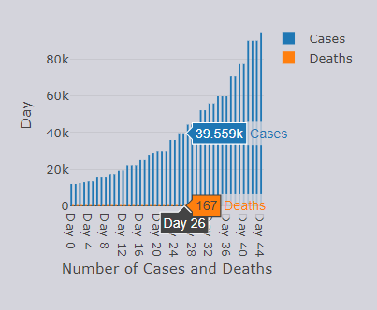
A bar chart can display the analysis result on individual virus effects over time.
This vertical analysis is comparing the cases between diagnostic confirmed and number of deaths.

Slide 8
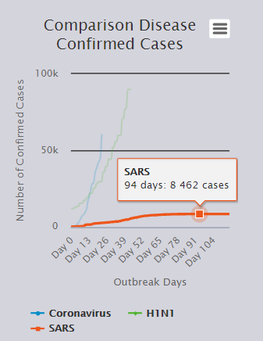
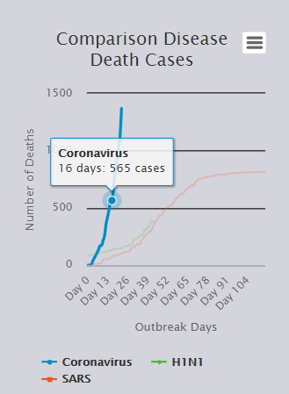
We use classical line chart for its intuitive demonstration ability. As you checking, you will find the line chart is easily to see different pattern that those 3 viruses formed.
The line chart analysis revealing the more current virus pandemic, the more live threatening.

Slide 9
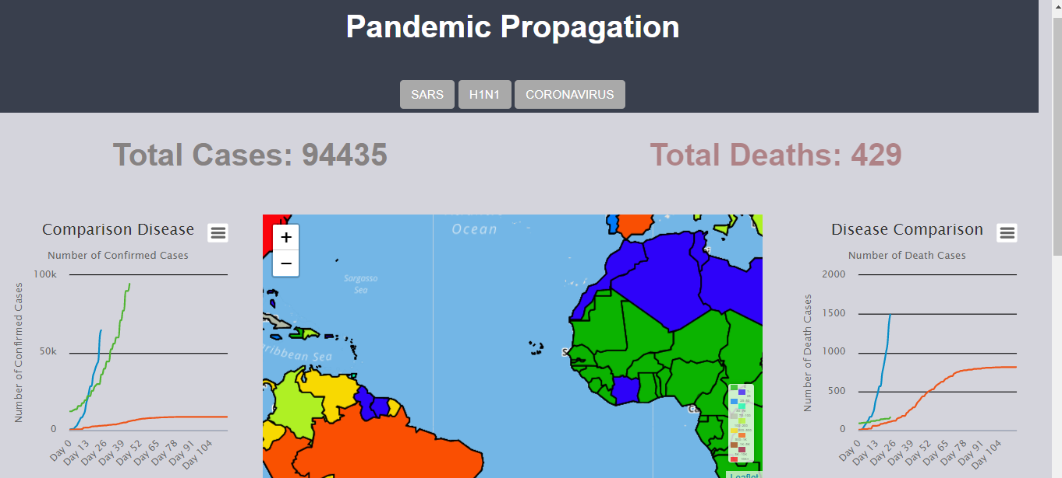

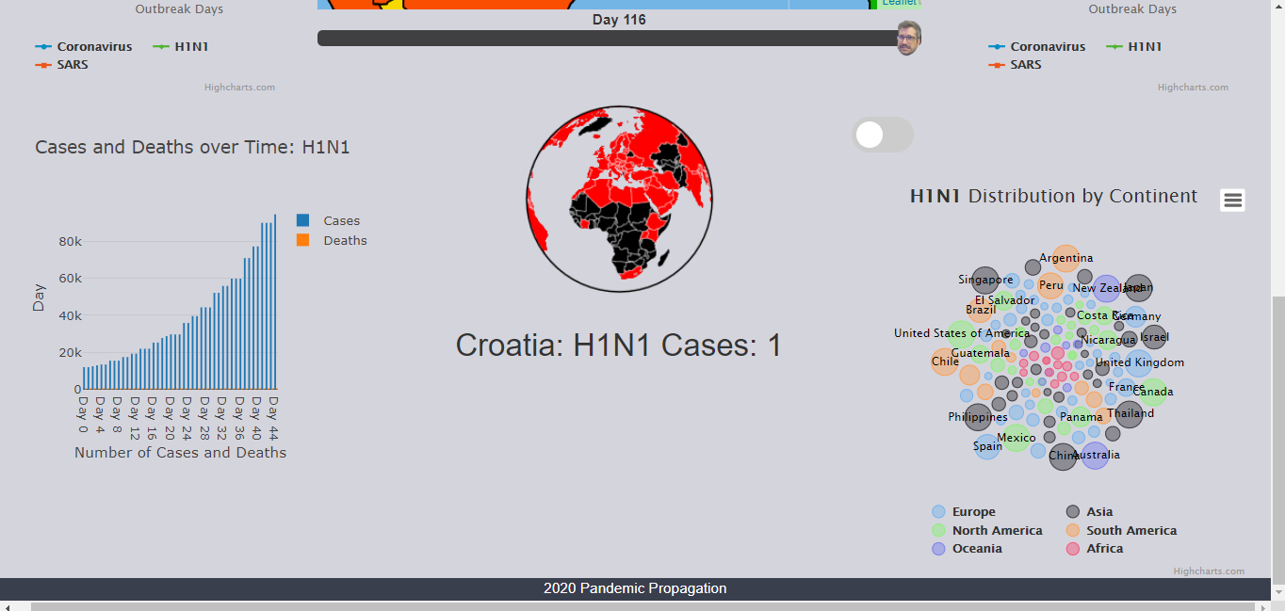
What a fantastic work
in just two weeks!
Cheers !

Slide 10
Conclusion:
For deadly viruses that spread globally, our analysis focused on the global effects and horizontal comparison.
The analysis showed every time the virus's outbreak, it’s power became more inexorable and more difficult to control because they were not follow the same trend, which cause higher deaths rate.
Our horizontal analysis can be helpful for people who interested on this topic.
Our analysis tend to use for public education, to raise public awareness of those pandemic. It will help public readiness and strategy making for those kind pandemic.

Slide 11

Credits:
Project Idea: Eliana
Data Resources: Eliana, Youssef,
Vaishall
Design, Styling: All
Flask: Vaishall
HTML, Line Charts: Eliana
Map: Vaishall, Xiaodi
Globe: Vaishall
Bubble Plot, Bar Chart: Youssef
Presentation: Xiaodi
Special Acknowledgement:
Project organization, Control: Vaishall

